Slide 1
IT 353 Web Development Technologies
Jianwei Lai
jlai12@ilstu.edu

Slide 2
Content for today
What is CSS?
Selectors
Box Model
Position

Slide 3
What is CSS?
CSS stands for Cascading Style Sheets
CSS describes how HTML elements are to be displayed on screen, paper, or in other media
CSS saves a lot of work. It can control the layout of multiple web pages all at once
External style sheets are stored in CSS files

Slide 4
Three styles
External Styles
Internal Style Sheet
Inline Styles
<head> <style> body { background-color: linen; } h1 { color: maroon; margin-left: 40px; } </style> </head>
<h1 style="color:blue;margin-left:30px;">This is a heading</h1>
<head> <link rel="stylesheet" type="text/css" href="mystyle.css"> </head>

Slide 5
Why external CSS?
Separate Content from Style
Content is the text and images, marked up to define regions of specific types
CSS defines the “style” for the content
<font size=“14px”>
My First Header
</font>
<font size=“12px” color=“red” face=“Verdana”>
My information 1 goes here.
</font>
<font size=“14px”>
My Second Header
</font>
<font size=“12px” color=“red” face=“Verdana”>
Different information goes here.
</font>
The old way:

Slide 6
Why external CSS?
Separate Content from Style
Content
Style
<p class="header">My First Header</p>
<p class="info">My Information 1 goes here</p>
<p class="header">My Second Header</p>
<p class="info">Different Information goes here</p>
.header { font-size: 28px;}
.info { font-family: verdana;
color: #999;
font-size: 22px; }

Slide 7

Why external CSS?
HTML limits the formatting possibilities that your pages require
Data and presentation are mixed within the same file
The required formatting tags and attributes make your pages larger and thus slower to load, display, and maintain.
With an external stylesheet file, you can change the look of an entire website by changing just one file!
<h1 style="color:blue;">This is a heading</h1> <p style="color:red;">This is a paragraph.</p>
Notes:
From the ASP book

Slide 8
What style will be used when there is more than one style specified for an HTML element?
External vs. internal vs. inline

Slide 9
Cascading Order
Inline style (inside an HTML element)
External and internal style sheets (in the head section)
Browser default
Inline style (inside a specific HTML element) has the highest priority
It will override a style defined inside the <head> tag, or in an external style sheet, or a browser default value.
<head> <link rel="stylesheet" type="text/css" href="mystyle.css"> <style> h1 { color: orange; } </style> </head>
<head> <style> h1 { color: orange; } </style> <link rel="stylesheet" type="text/css" href="mystyle.css"> </head>
vs.
Notes:
It based on the order. What if you define the same thing twice?
h1 {
color: green;
text-align: center;
}
.title{ /* h1 has a class name title */
color: purple;
}
h1 {
color: green;
text-align: center;
}
.title{
color: purple;
}
<!DOCTYPE html>
<html>
<head>
<style>
body {
background-color: lightblue;
}
h1 {
color: white;
text-align: center;
}
p {
font-family: verdana;
font-size: 20px;
}
</style>
</head>
<body>
<h1 style ="color: yellow;">My First CSS Example</h1>
<p>This is a paragraph.</p>
</body>
</html>
<link rel="stylesheet" href="styles.css">
h1 {
color: green;
text-align: center;
}

Slide 10
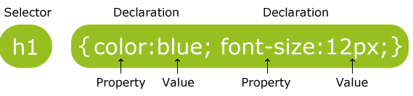
CSS syntax
The element Selector
The id Selector
The class Selector
p { color: red; text-align: center; }
#para1 { text-align: center; color: red; }
.center { text-align: center; color: red; }

Slide 11
You can also specify that only specific HTML elements should be affected by a class
p.center { text-align: center; color: red; }
only <p> elements with class="center" will be center-aligned
h1, h2, p { text-align: center; color: red; }
Grouping Selectors

Slide 12
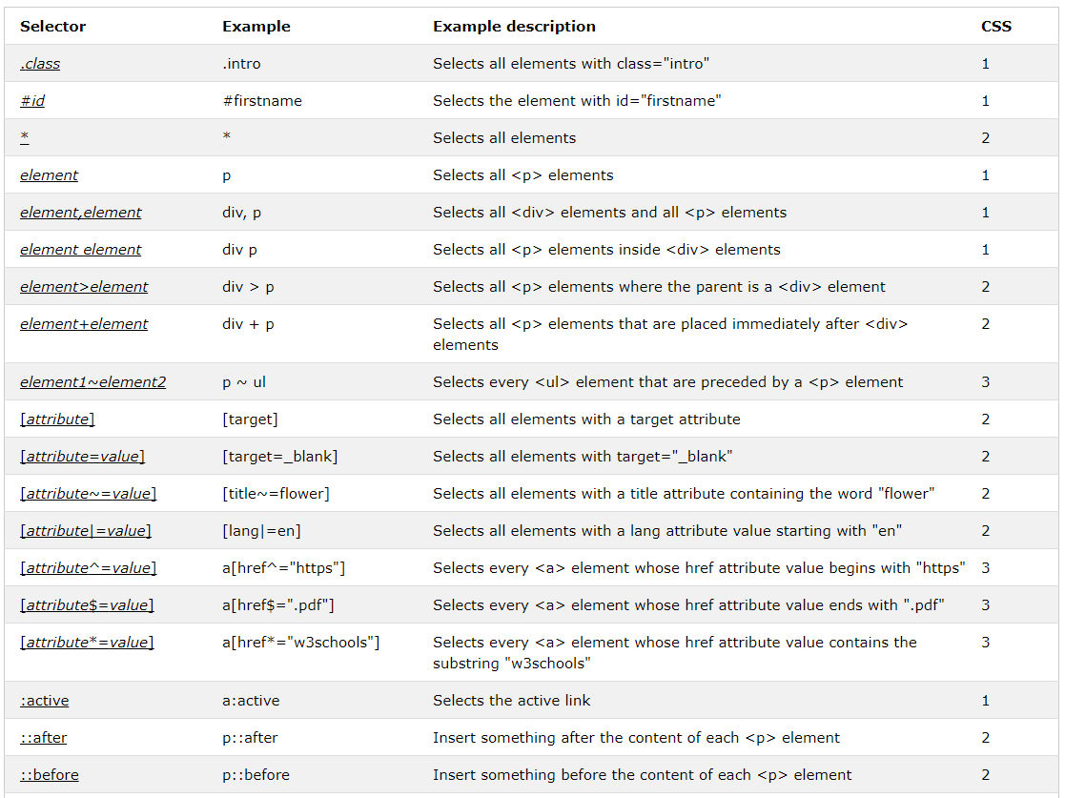
Selectors
https://www.w3schools.com/cssref/css_selectors.asp

Slide 13
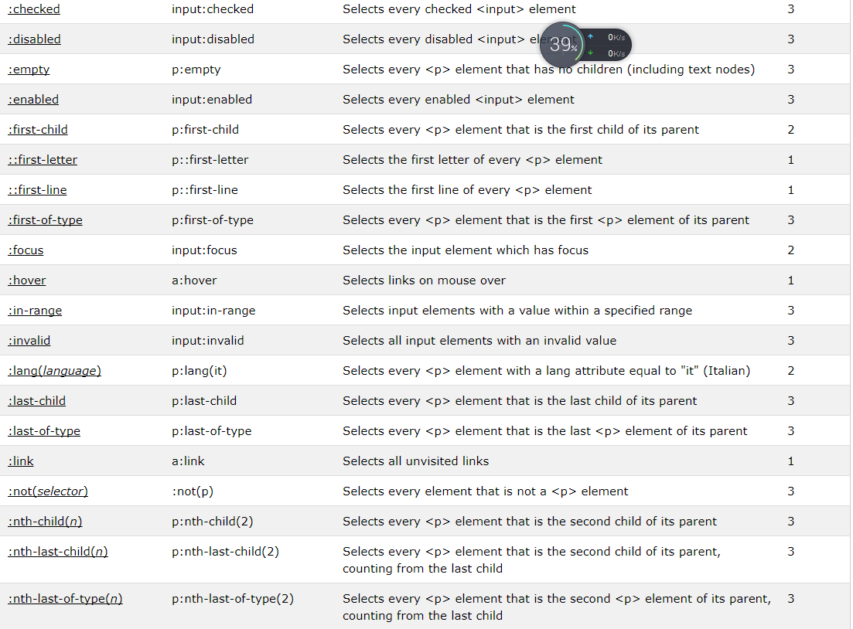
Selectors
To see the whole list https://www.w3schools.com/cssref/css_selectors.asp

Slide 14
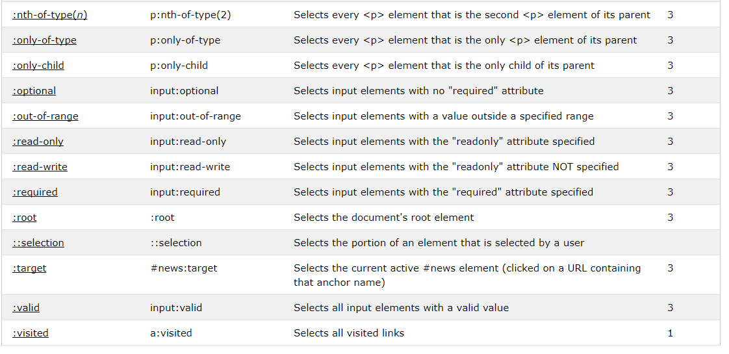
To see the whole list https://www.w3schools.com/cssref/css_selectors.asp

Slide 15
Pseudo-classes
/* unvisited link */ a:link { color: #FF0000; } /* visited link */ a:visited { color: #00FF00; } /* mouse over link */ a:hover { color: #FF00FF; } /* selected link */ a:active { color: #0000FF; }
Try it out https://www.w3schools.com/css/tryit.asp?filename=trycss_link

Slide 16
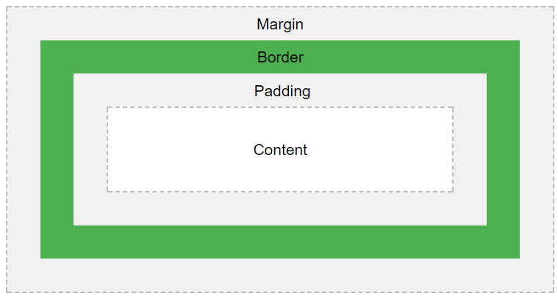
The CSS Box Model
All HTML elements can be considered as boxes. In CSS, the term "box model" is used when talking about design and layout.
The CSS box model is essentially a box that wraps around every HTML element.
Content - The content of the box, where text and images appear
Padding - Clears an area around the content. The padding is transparent
Border - A border that goes around the padding and content
Margin - Clears an area outside the border. The margin is transparent
Notes:
border: 5px solid gray;
<!DOCTYPE html>
<html>
<head>
<style>
body {
background-color: lightblue;
}
h1 {
color: white;
text-align: center;
}
p {
font-family: verdana;
font-size: 20px;
}
</style>
</head>
<body>
<h1 style ="color: yellow;">My First CSS Example</h1>
<p>This is a paragraph.</p>
</body>
</html>

Slide 17
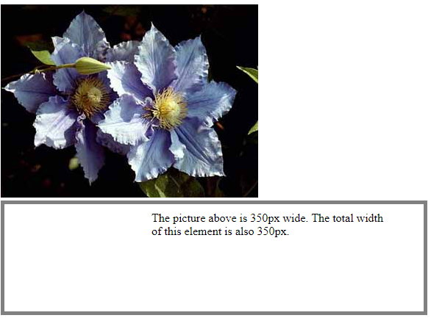
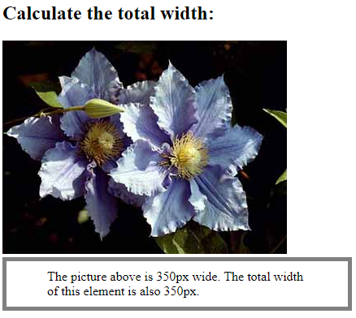
div {
width: 320px;
padding: 10px 50px 100px 200px;
border: 5px solid gray;
margin: 0;
}
div {
width: 320px;
padding: 10px 50px;
border: 5px solid gray;
margin: 0;
}
https://www.w3schools.com/css/tryit.asp?filename=trycss_boxmodel_width
Notes:
Can you treat the image as a box?
Try
img {
width: 420px;
margin: 50px;
}
Can the box apply to a button?
<button type="submit">Click Me!</button>
button[type="submit"] {
width: 420px;
}

Slide 18
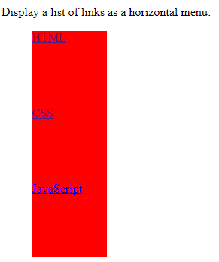

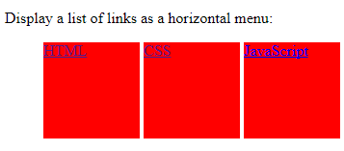
Display
block vs inline vs inline-block
li {
height: 100px;
width: 100px;
background-color: red;
display: inline;
}
li {
height: 100px;
width:100px;
background-color: red;
display: block;
}
li {
height: 100px;
width: 100px;
background-color: red;
display: inline-block;
}
https://www.w3schools.com/cssref/tryit.asp?filename=trycss_display
Notes:
https://www.w3schools.com/cssref/pr_class_display.asp
Add border and padding to make it clearer
border: 5px solid gray; padding: 50px;

Slide 19
The Position Property
Static
Relative
Fixed
Absolute
Sticky

Slide 20
Normal Flow – no “positioning”
Left to Right, Top to Bottom

Slide 21
Normal Flow – no “positioning”
Top left of the page = (0,0)
Left to Right, Top to Bottom

Slide 22
The Position Property
position: static;
HTML elements are positioned static by default.
Static positioned elements are not affected by the top, bottom, left, and right properties.
An element with position: static; is not positioned in any special way;
it is always positioned according to the normal flow of the page:
https://www.w3schools.com/css/tryit.asp?filename=trycss_position_static
Notes:
top: 100px;
Change to position: relative;

Slide 23
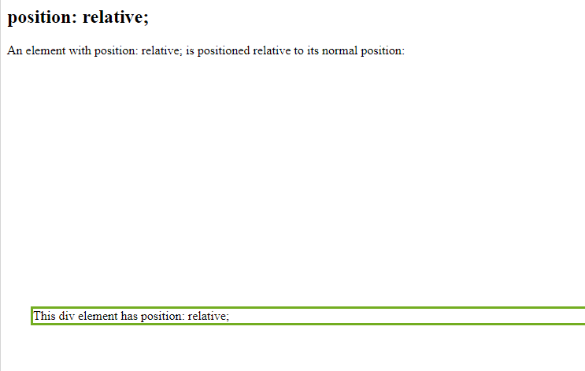
The Position Property
position: relative;
Setting the top, right, bottom, and left properties of a relatively-positioned element will cause it to be adjusted away from its normal position.
Other content will not be adjusted to fit into any gap left by the element.
div.relative {
position: relative;
top: 300px;
left: 30px;
border: 3px solid #73AD21;
}
https://www.w3schools.com/css/tryit.asp?filename=trycss_position_relative

Slide 24
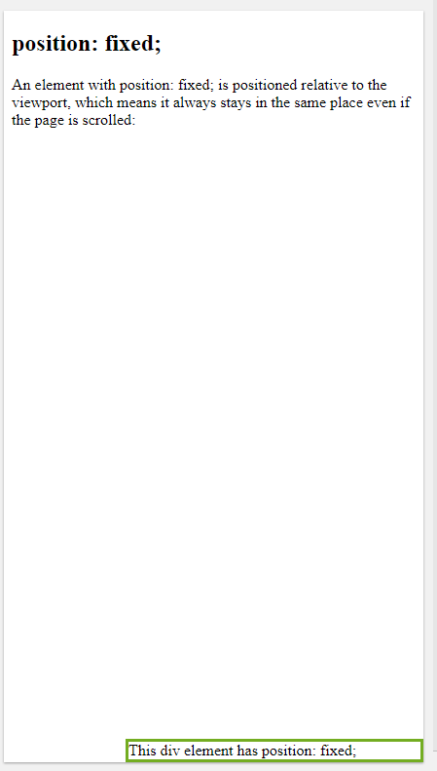
The Position Property
position: fixed;
An element with position: fixed; is positioned relative to the viewport, which means it always stays in the same place even if the page is scrolled.
The top, right, bottom, and left properties are used to position the element.
div.fixed {
position: fixed;
bottom: 0;
right: 0;
width: 300px;
border: 3px solid #73AD21;
}
https://www.w3schools.com/css/tryit.asp?filename=trycss_position_fixed

Slide 25
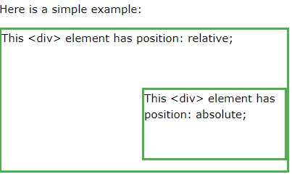
The position Property
position: absolute;
a element is positioned relative to the nearest positioned ancestor (instead of positioned relative to the viewport, like fixed).
A "positioned" element is one whose position is anything except static.

Slide 26
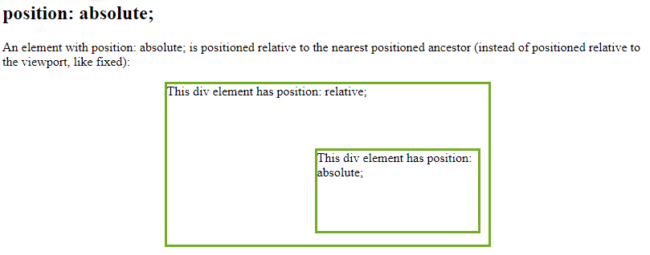
div.relative {
position: relative;
width: 400px;
margin: auto; /*center the box*/
height: 200px;
border: 3px solid #73AD21;
}
https://www.w3schools.com/css/tryit.asp?filename=trycss_position_absolute
Notes:
Get rid of position: relative; to see the difference
Add a parent class to be the new parent for the absolute class
<div class="parent">
<div class="relative">This div element has position: relative;
<div class="absolute">This div element has position: absolute;</div>
</div>
div.parent {
position:absolute;
top: 200px;
width: 500px;
height: 500px;
border: 10px solid #666;
}

Slide 27
The Position Property
position: sticky;
An element with position: sticky; is positioned based on the user's scroll position.
A sticky element toggles between relative and fixed, depending on the scroll position. It is positioned relative until a given offset position is met in the viewport - then it "sticks" in place (like position:fixed).
https://www.w3schools.com/css/tryit.asp?filename=trycss_position_sticky
Notes:
https://www.w3schools.com/howto/howto_css_sticky_element.asp

Slide 28
Static: Static doesn't mean much; it just means that the element will flow into the page as it normally would. The only reason you would ever set an element to position: static; is to forcefully remove some positioning that got applied to an element outside of your control.
Relative: This type of positioning is probably the most confusing and misused. What it really means is "relative to itself".
Fixed: A fixed position element is positioned relative to the viewport, or the browser window itself.
Absolute: You use the positioning attributes top, left, bottom, and right to set the location. Remember that these values will be relative to the next parent element with relative or absolute positioning.

Slide 29
z-index Property
When a relative, absolute, or fixed element is placed on top of another positioned element, the element that is specified last in the HTML is placed on top
The z-index property is used to specify a relative distance that orders the appearance of elements
Elements with higher z-index values are placed on top of elements with lower z-index values
https://www.w3schools.com/css/tryit.asp?filename=trycss_zindex

Slide 30
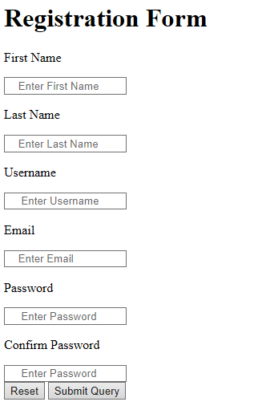
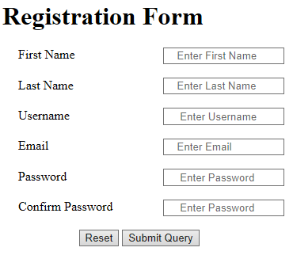
A question for you
How to center the registration form and align the text fields to the right?
Notes:
<!DOCTYPE html>
<html>
<head>
<title>Title of the document</title>
<style>
div {
margin-bottom: 10px;
}
label {
display: inline-block;
width: 150px;
}
form {
width: 350px;
margin: auto;
border: 3px solid #73AD21;
}
</style>
</head>
<body>
<form action="/form/submit" method="post">
<div>
<label for="name">Name</label>
<input type="text" id="name" placeholder="Enter your name" />
</div>
<div>
<label for="age">Your Age</label>
<input type="text" id="age" name="age" placeholder="Enter your age" />
</div>
<div>
<label for="country">Enter Your Country</label>
<input type="text" id="country" name="country" placeholder="Country" />
</div>
<input type="submit" value="Submit" />
</form>
</body>
</html>

Slide 31
Before next class
https://www.w3schools.com/css/
http://learn.shayhowe.com/html-css/getting-to-know-css/

Slide 32
Assignment 1 due 9/1 on Reggienet

